Slide 1
COMP9312
Data Analytics for Graphs
Dong Wen, Michael Yu
22T2

Slide 2


Lecturers
Dr. Dong Wen (LiC)
cse.unsw.edu.au/~dwen/
Dr. Michael Yu
Tutors
Research students from Data and Knowledge Research Group in CSE
Peter Xu and Jianwei Wang

Slide 3
Course Information
Lectures: lectures will be delivered live online. Recorded video will be made available.
4 PM – 6 PM (Monday) week 1 – 2, 4 – 5, 7 – 10
4 PM – 6 PM (Tuesday) week 1 – 5, 7-10
Tutorials: Detailed tutorial notes will be provided on WebCMS3.
Week 2-5, 7-10.
Consultation: Lecturer/admin will answer questions.
Week 2, 4 – 5, 7 – 10. 6PM – 7PM (Tuesday)

Slide 4
Course Information (cont)
Course Email:
comp9312unsw@gmail.com or dong.wen@unsw.edu.au
For normal questions, we recommend you use the Q&A forums. You are also welcome to contact us via course email if something is urgent.
Welcome to book private help sessions.
Forum: https://webcms3.cse.unsw.edu.au/COMP9312/22T2/forums/
Webcms3: https://webcms3.cse.unsw.edu.au/COMP9312/22T2/
Moodle: https://moodle.telt.unsw.edu.au/course/view.php?id=67871

Slide 5
Teaching/Learning
What we do to support your learning:
Online Lectures
Tutorials (starting from Week 2, online+offline): guides you through the theoretical knowledge and practical skills of the course, solutions will be released after all the tutorials are delivered.
Private help sessions.
Assignments and projects
Textbook & papers
Online lecturer and tutorial recordings can be found on Moodle (Lectures and Recordings)

Slide 6
Syllabus Overview
Traditional algorithms on Graphs / Graph Database (Week 1 to Week 5)
Basic concepts of graphs
Graph traversal – DFS, BFS, connectivity, etc.
Path and reachability queries
Cohesive subgraph mining
Machine learning methods on Graphs (Weeks 7 to 10)
Basic machine learning methods
Traditional machine learning methods on graphs
Graph neural networks
Share your suggestions/comments/experience~

Slide 7
Your Background
We assume that you …
Have some background in data structure and algorithms
Have some experience with programming languages, e.g., Python
Hopefully, have some knowledge of relational databases
You might have acquired this background in
COMP1511, COMP1531, COMP2521, COMP3311, COMP9311
Introduce yourself (Name, major, have you every learned any graph algorithms…)
Online poll:
https://docs.google.com/forms/d/e/1FAIpQLSfQUbsyvubjATUakOy5_NybzbH2zz70wkHZpuvWQnPgjJBsEQ/viewform?usp=sf_link

Slide 8
Textbook
Lecture notes are sufficient, but the following materials are good:
Reference Books:
Introduction to algorithms by Thomas H, Cormen, et al
Cohesive subgraph computation over large sparse graphs: algorithms, data structures, and programming techniques by Lijun Chang and Lu Qin.
Graph Representation Learning by William L. Hamilton
Networks, Crowds, and Markets: Reasoning About a Highly Connected World by David Easley and Jon Kleinberg
Network Science by Albert-László Barabási

Slide 9
Assignments
Two assignments are done individually.
Submitted via Moodle
Plagiarism-checked (copying solutions => 0 mark for the assignment)
Assignments (25%):
Ass 1: Graph Traversal; Reachability/Path Queries (15%) (week 2-4)
Ass 2: Graph Neural Networks (10%) (week 9-10)

Slide 10
Project
Done individually
Submitted via Moodle
Projects (25%)
Cohesive Subgraph Mining; Machine Learning Methods on Graphs (week 5-8)

Slide 11
Exam and Marks
Exam: 50%
Graph Algorithms + Graph Neural Network
Exam is open for 4 hours.
All answers are submitted via Moodle
If you are ill on the day of the exam, do not attend the exam.
Sample questions will be available in Week 10
Final mark = Ass1 + Ass2 + Project + Exam
Pass the course: Final mark >= 50

Slide 12
Supplementary Exam Policy
Everyone gets exactly one chance to pass the Exam.
If you attempt the Exam
We assume you are fit/healthy enough to take it.
No 2nd chance exams, even with a medical certificate.
Special consideration:
If you are ill on the day of the exam, do not attend the exam.
All special consideration requests must be submitted to UNSW.
All special consideration requests must document how you were effect.

Slide 13
Beyond the course
Research Degrees: (https://research.unsw.edu.au/higher-degree-research-programs)
PhD (3 -- 3.5 years)
Master of Philosophy (1.5 -- 2 years)
Feel free to contact me if you are interested in obtaining a research degree.
Requirement:
GPA>80 with education from world top 400 universities. GPA > 75 if from world top 100 universities. Local students are particularly welcome to apply.
Data and Knowledge Research Group in CSE:
https://unswdb.github.io/

Slide 14
Outline
Basic Concepts
What are networks/graphs?
Characterization of graphs
How to characterize graphs?
Analysing of graphs
How to analyse graphs data?
Applications of graphs
Applications of graphs analysis

Slide 15
Why Graphs?
Graph is a general language for describing and analyzing entities with relations/interactions.

Slide 16
users, machines, webpages, road intersections, and any entities…

Slide 17
Network / Graph

Slide 18
Types of Networks and Graphs
Graphs (also known as Networks):
Social networks:
Society is a collection of 7+ billion individuals
Communication and transactions:
Electronic devices, phone calls, financial transactions
Biomedicine:
Interactions between genes/proteins regulate life
Brain connections:
Our thoughts are hidden in the connections between billions of neurons
. . .

Slide 19
Types of Networks and Graphs (cont)
Graphs (as a representation):
Information/knowledge are organized and linked
Software can be represented as a graph
Relational structures: Molecules, Scene graphs, 3D shapes, Particle-based physics simulations
Sometimes the distinction between networks & graphs is blurred

Slide 20
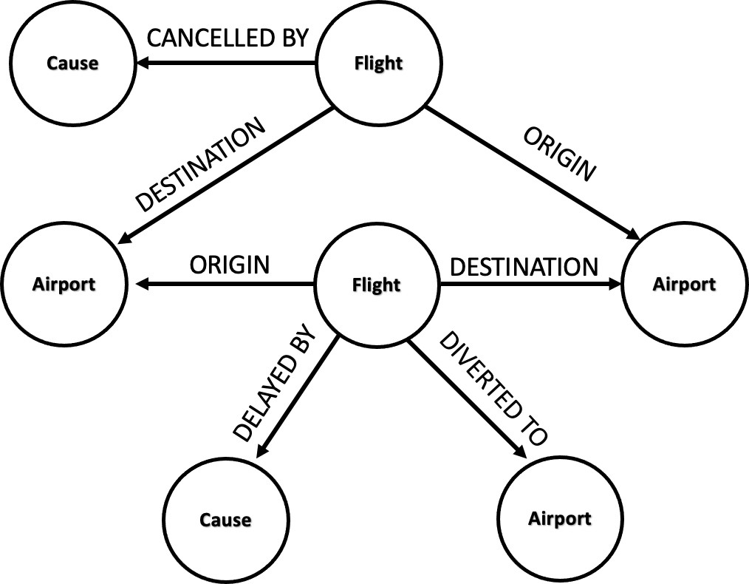

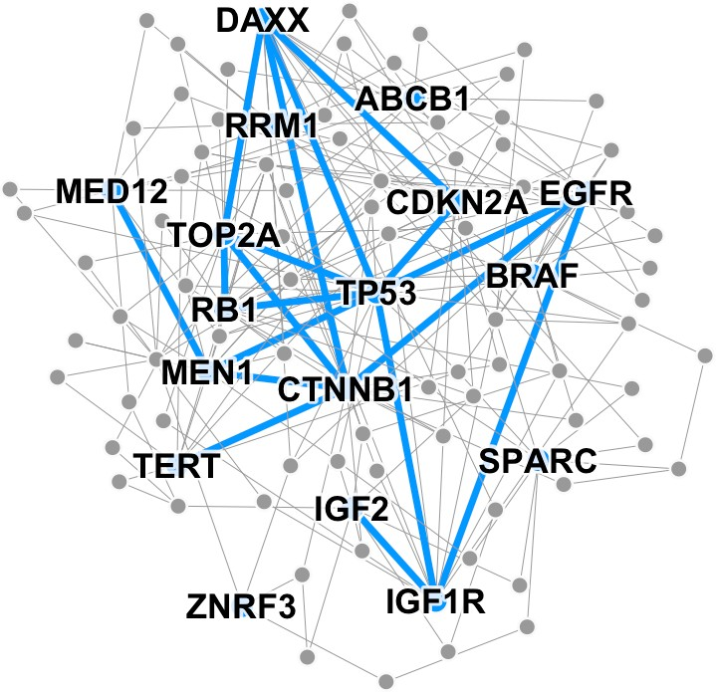
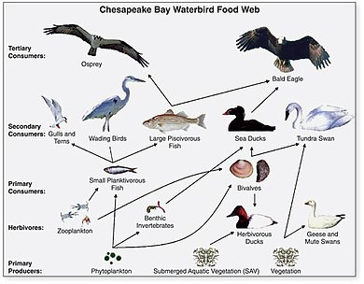
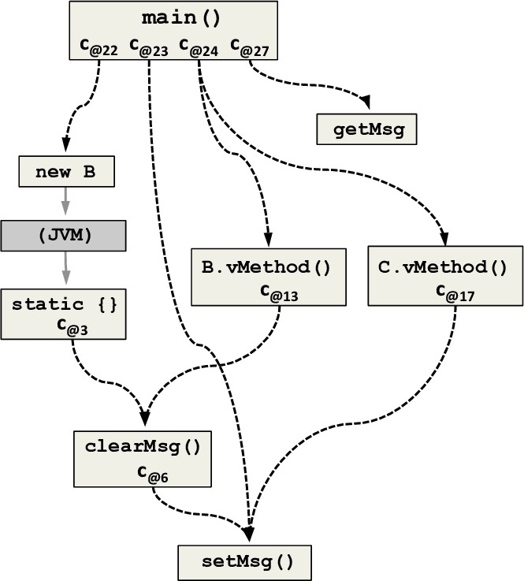
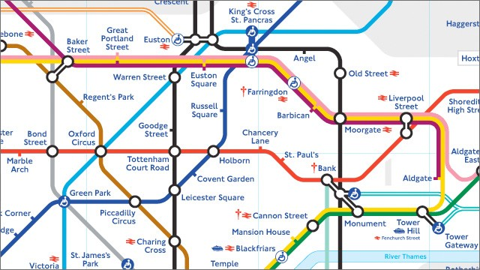
Many Types of Data are Graphs (1)
Image credit: SalientNetworks
Computer Networks
Event Graphs
Disease Pathways
Image credit: Wikipedia
Image credit: ResearchGate
Code Graphs
Image credit: visitlondon.com
Underground Networks
Food Webs
Notes:
In addition to the social and information network studied in this subject, there are many other types of networks. E.g., Internet : routers
Road network : Brain : 10-100 billion neurons, Protein : interactions , recently

Slide 21
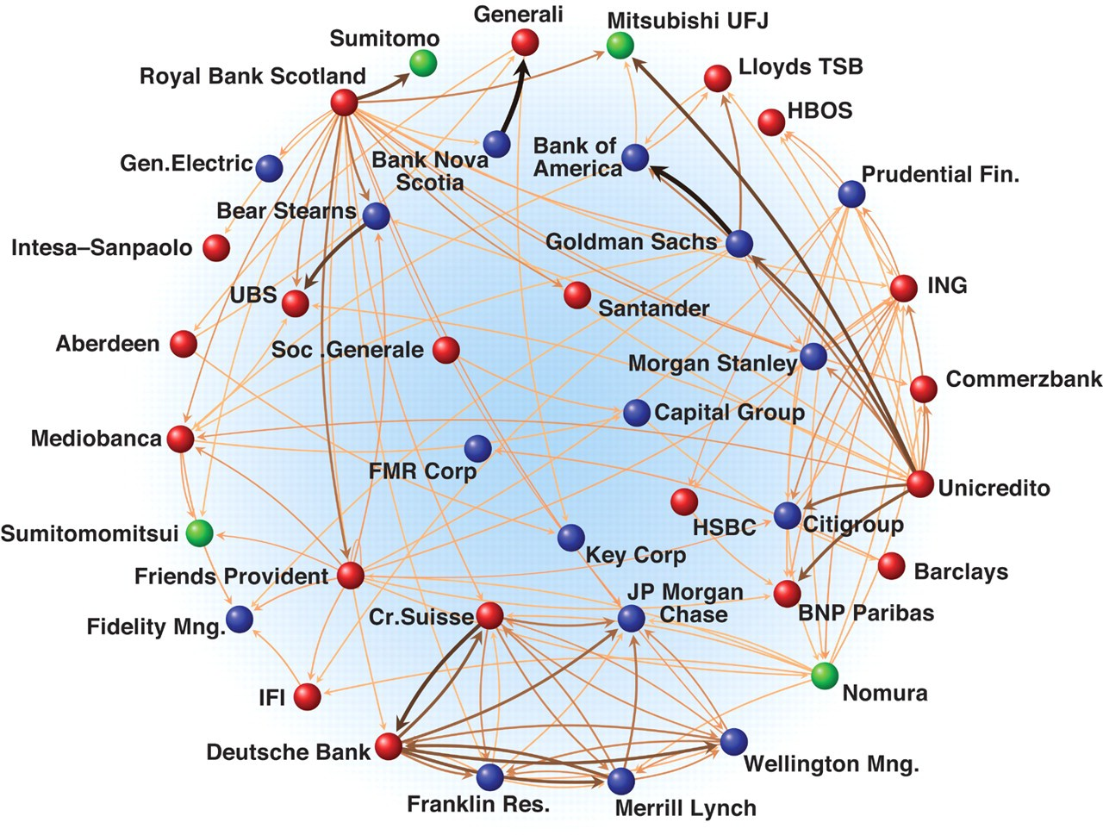
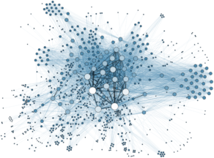
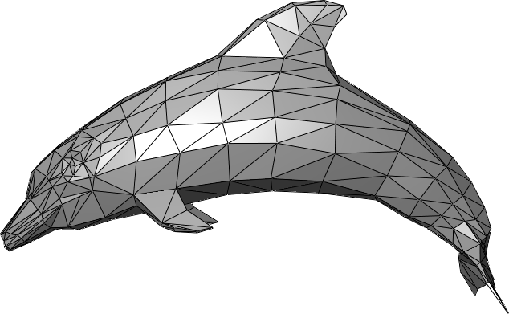

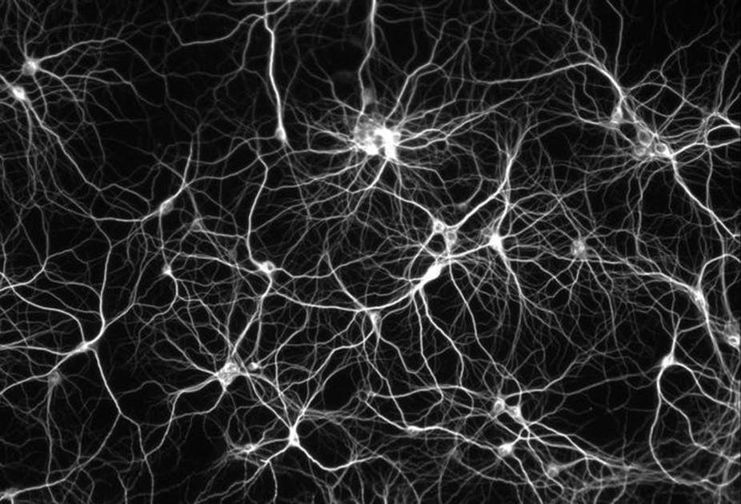
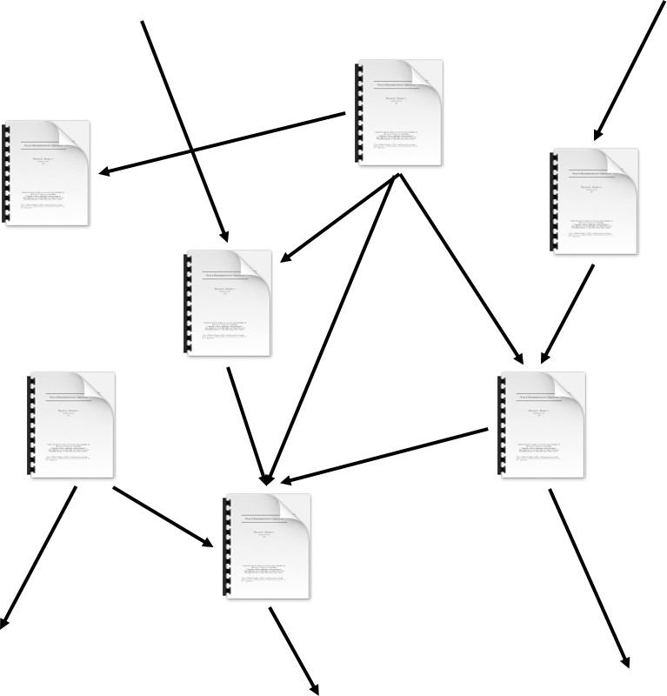
Many Types of Data are Graphs (2)
Image credit: Science
Image credit: Wikipedia
Image credit: Lumen Learning
3D Shapes
Economic Networks Communication Networks
Image credit: Missoula Current News
Internet
Image credit: The Conversation
Networks of Neurons
Citation Networks
Notes:
In addition to the social and information network studied in this subject, there are many other types of networks. E.g., Internet : routers
Road network : Brain : 10-100 billion neurons, Protein : interactions , recently

Slide 22
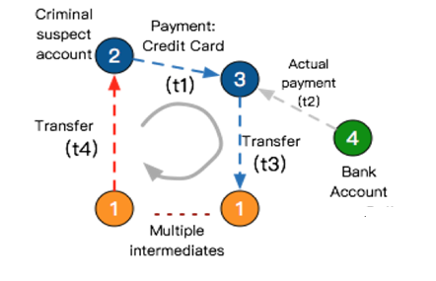
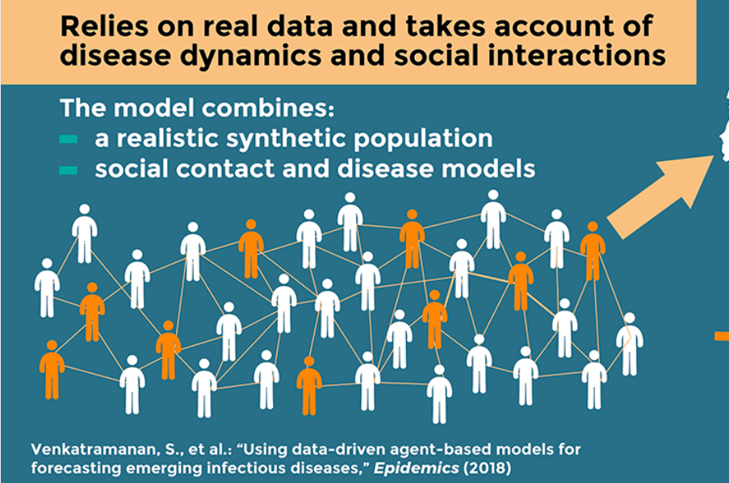
Why we study networks/graphs ?
Networks / graphs are everywhere, and we live in a highly-connected world.
In many applications, we need analyze in the context of networks, not just individuals.
Money laundering detection
Predict the spread of virus
Notes:
Nowadays, we live in a highly connected world. e.g., easy to reach a place, to reach a person or to find information
I believe you may have your own examples about networks;
Given various kind of network data, it is essential for us to investigate the problem in the context of networks. That is, in addition to each individual object, we also need to consider the topology of the objects.
in some application, we can achieve better performance if we consider the problem in the context of networks.
--- In recent years, I have had conversations with my friends in some big IT companies such as Alibaba, Facebook, and Google. To have a good KPI, you need to try something new. A new trend is to integrate the network information to further enhance the performance of their systems.
Following are two examples;
Money laundering detection. (transform dirty money into clean money)
Predict the spread of the virus. Ideally, if we can model the graph based on the social distancing measures between people, for example, two people are connected if they are family members or have dinner together recently, then by applying some probabilistic models, for instance, how likely a person will be infected by the given social distancing measure, then we can precisely prediction the spread of a virus.

Slide 23
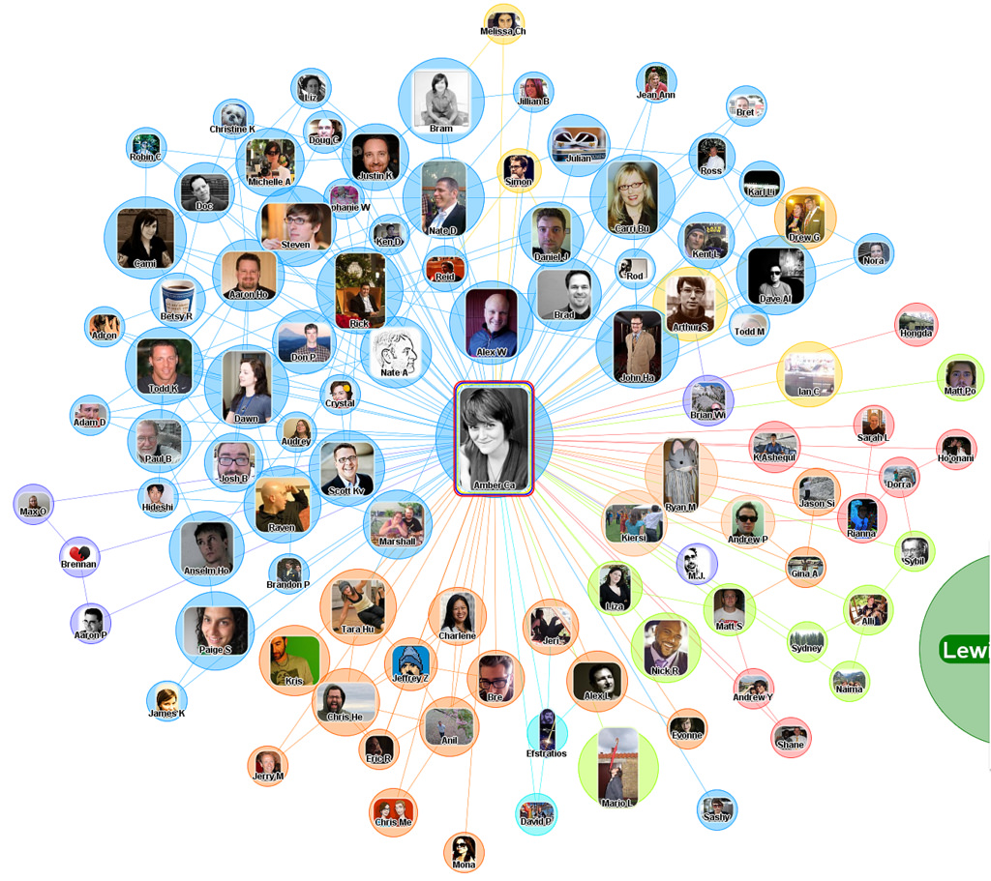
Social Networks – Facebook ego-network
Find your communities
Know how to approach a person via Facebook.
e.g., how to increase the chance of getting your friend invitation accepted?
Notes:
When I start designing this subject, I feel the Facebook ego-network is a perfect example.
Here, a node is a person and the link shows the friendship.
An ego-network on Facebook is constructed like this:
Firstly, you are the centre of this network, then connected to your friends .
Then we also consider the connection between them.
By using some visualization and analysis tools (e.g., gephi), very likely, you will find some communities.
Such as friends from the high school, friends from the University and friends from the same club
Because they are likely to know each other.
Or the students in this subject, it also provide an opportunity to form a community.

Slide 24
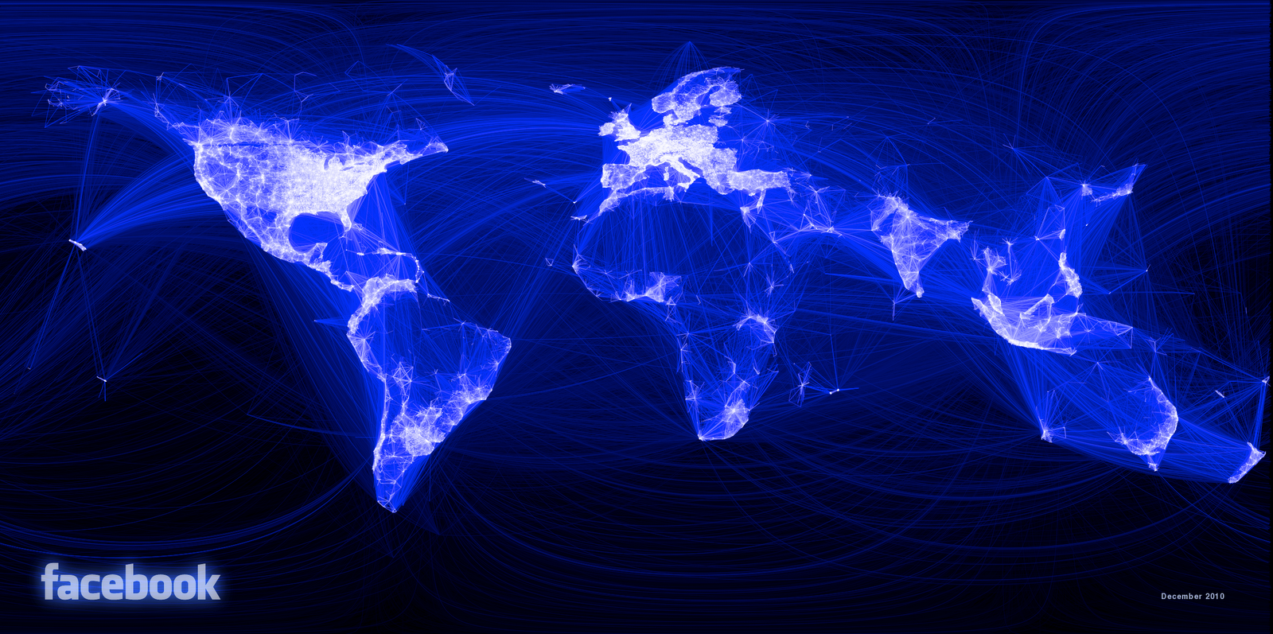
Social Networks – Facebook (location based visualization in 2011)
Monthly active users: around 1 billion in 2012 and 2.32 billion (2017) - now around 2.5 billion (2020)
Facebook social graph [Backstrom-Boldi-Rosa-Ugander-Vigna, 2011]
Notes:
Nowadays, there are around 2.5 billion monthly active users on Facebook. Here is an
visualization of the Facebook
This is a location-based visualization of Facebook network in 2011, Clearly see some hot areas : north America , Europe,

Slide 25
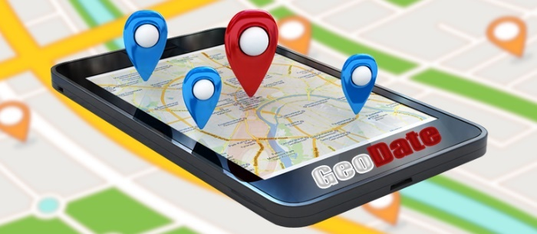
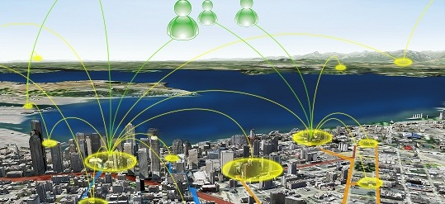

Social Networks – Location Based Social Network (LBSN)
https://www.microsoft.com/en-us/research/project/location-based-social-networks
Notes:
We also have location based social network, due to the popularity of smart phone, we can easily find the locations of users. This is critical in many applications such as Point of Interests recommendation, car booking like uber !

Slide 26
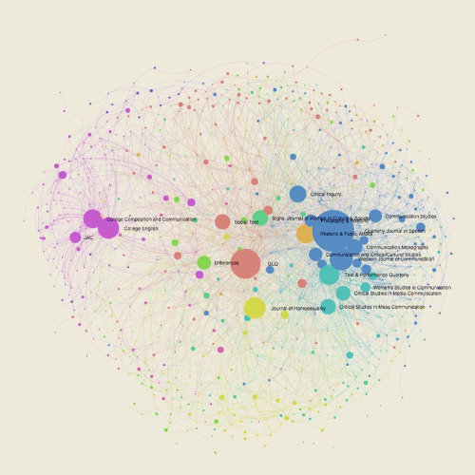
Social Networks – Citation Network
Citation Network is a social network which contains paper sources and linked by co-citation relationships
http://michaeljfaris.com/blog/2015/08/2353652015-visualizing-citation-networks/
Notes:
Citation Network is a Social network which contains paper sources and linked by co-citation relationships.
Say a node is paper, and there is a directed edge between two papers a and b if a cites b.
Based on the citation network, we can find the most influential papers (heavily cited);
Example, R-tree, only one paper, not continue , but extremely high citation;
An important evaluation of the impact for your track record; Especially for some prestigious fellowship such as ACM fellow and IEEE fellow

Slide 27
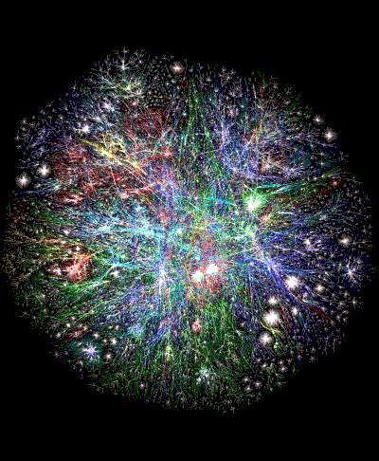
Information Networks – WWW
3D Map of the World Wide Web
This illustrates in 3-D the actual domains and connections of the world wide web. Colors have
been added to represent .edu, .gov, .com, etc. domains.
http://www.vlib.us/web/worldwideweb3d.html
Notes:
Node : webpages , link : hyper links
We can get “every thing” from WWW, massive information
This is a 3D illustration xxxxxx
How to organize and how to search !!
Internet is the key for the organization, and Google is the key to help us to explore it !

Slide 28
Characterization of graphs

Slide 29








Components
Objects: nodes, vertices
Interactions: links, edges
Systems: networks, graphs
V E
G(V, E)
Notes:
Capital V and Capital E

Slide 30
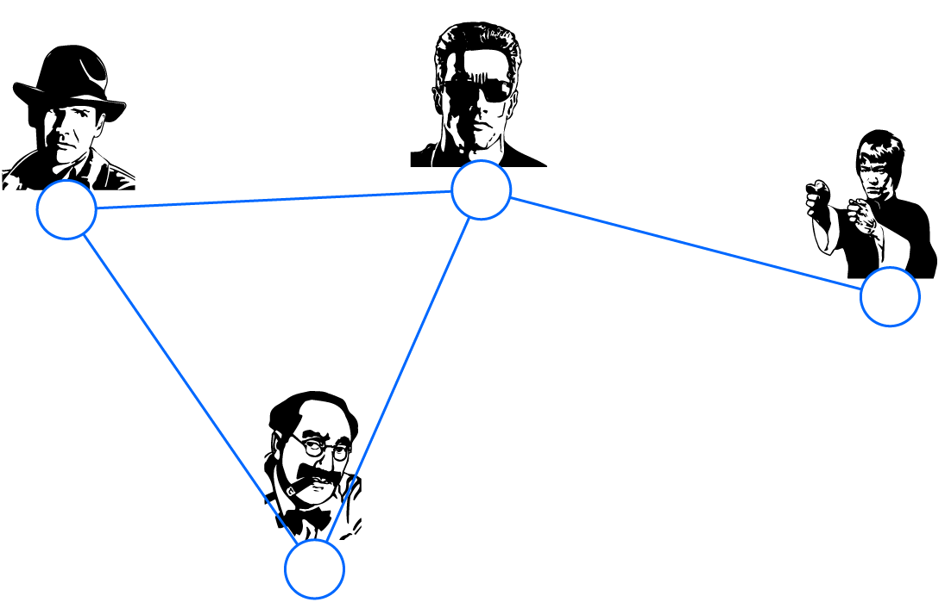
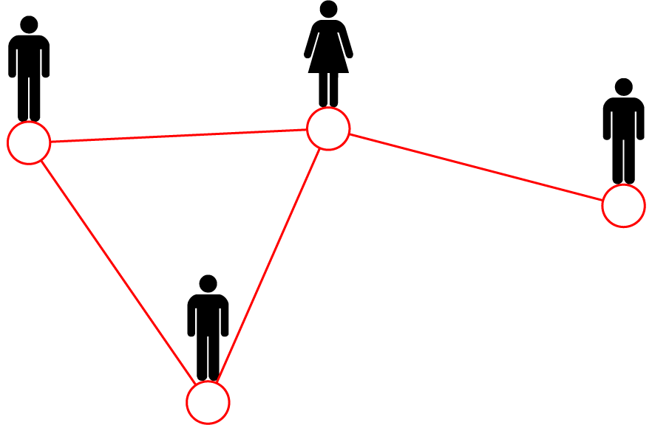
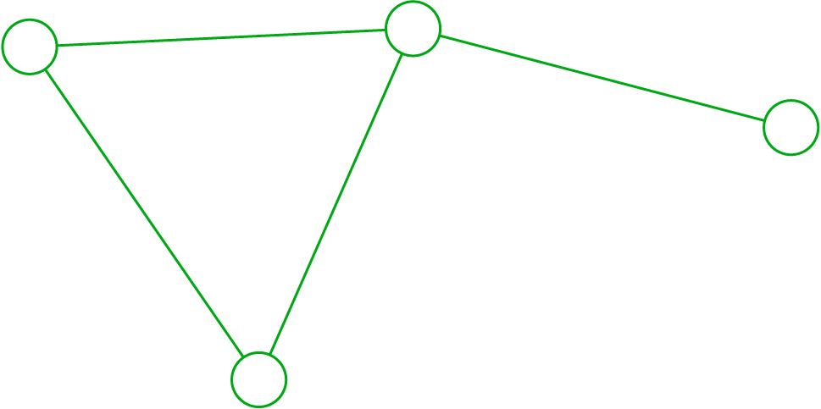
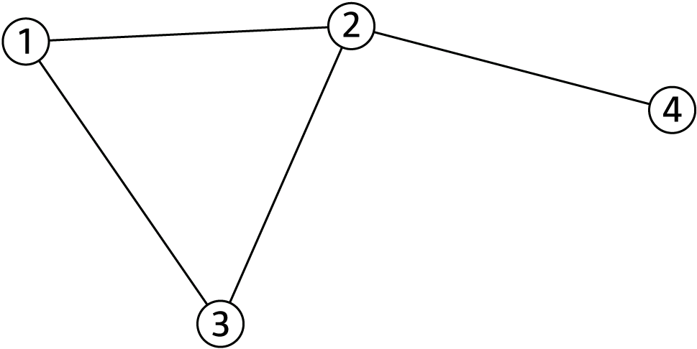
Graphs: A Common Language
Movie 1
friend
Actor 1
Actor 2
Mary
co-worker
Peter
Movie 3
Actor 4
Tom
Movie 2
brothers
friend
Actor 3
Albert
Protein 1
Protein 2
Protein 5
|V|=4 or n=4
|E|=4 or m=4
Protein 9
Notes:
There are multiple types of systems in real-world application, for example, actor interactions, social interactions, and protein-interactions
All these systems can be described using a common language which is graph. We can use the graph in the right bottom, which includes 4 vertices and 4 edges.

Slide 31
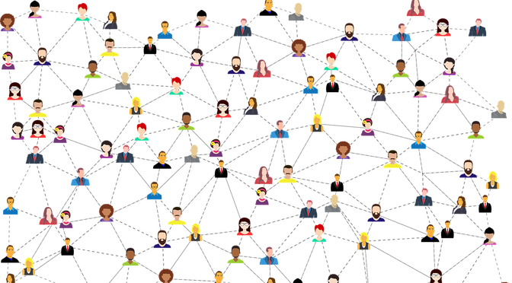
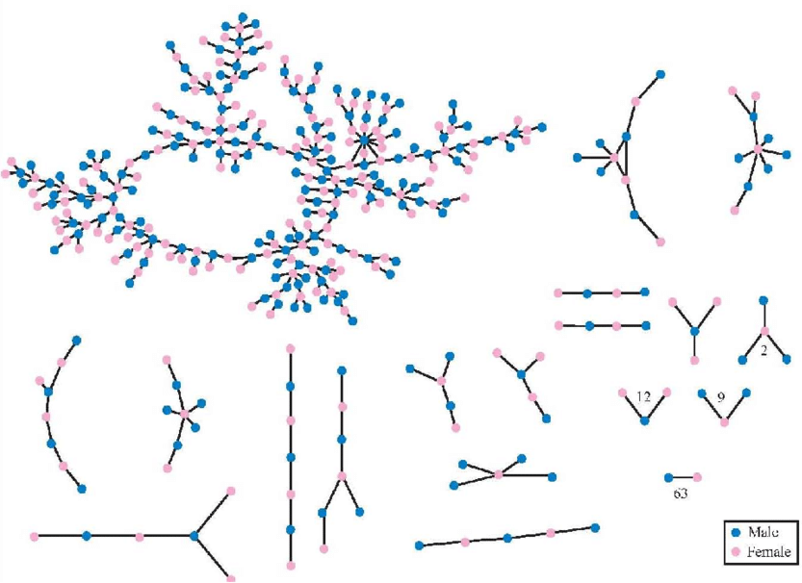
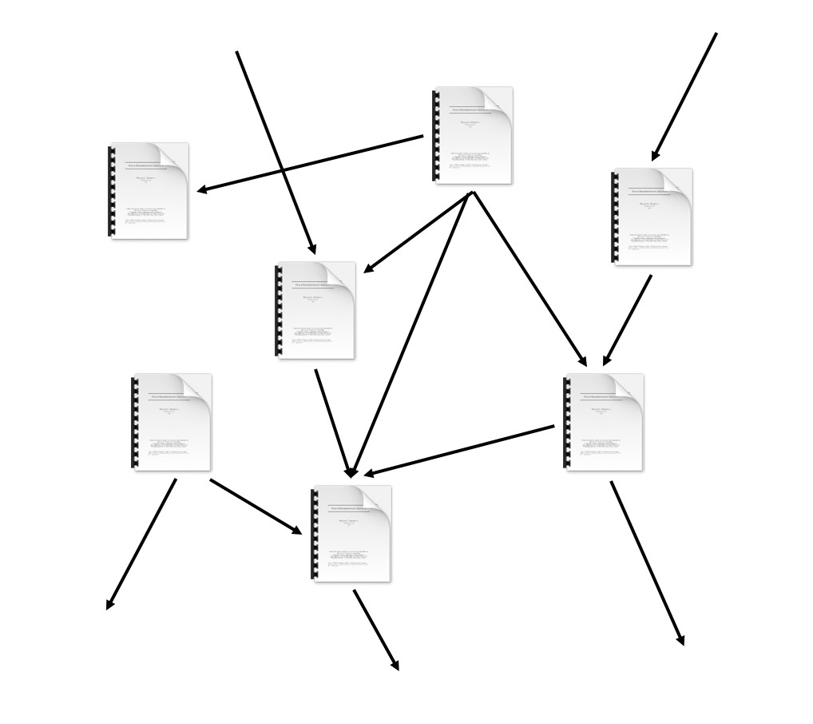
Choosing a Proper Representation
If you connect individuals that work with each other, you will explore a professional network
If you connect those that have a sexual relationship, you will be exploring sexual networks
If you connect scientific papers
that cite each other, you will be studying the citation network
Image credit: Euro Scientists
Image credit: ResearchGate
If you connect all papers with the same word in the title, what will you be exploring? It is a graph/network, nevertheless
Notes:
The graph meaning less as some relationships are not meaningful. For example, we cannot say two paper both containing "for" has some relationship. It is hard to find something useful from this graph.

Slide 32
Ho do you define a graph?
How to build a graph:
What are vertices?
What are edges?
Choice of the proper network representation is important:
The way you assign links will determine the nature of the question you can study
Notes:
In some cases there is a unique, unambiguous representation
In other cases, the representation is by no means unique

Slide 33
Quick quiz
How to build a graph for the email scenario:
User (email address, …)
Email (from, to, cc, email content)
…
Quiz Link:
https://docs.google.com/forms/d/e/1FAIpQLSd2CFTMcri1uZ4JcQGH_LdTI6CTFZzSVw6BPT5hgHRtR9or2w/viewform?usp=sf_link
Notes:
In some cases there is a unique, unambiguous representation
In other cases, the representation is by no means unique

Slide 34
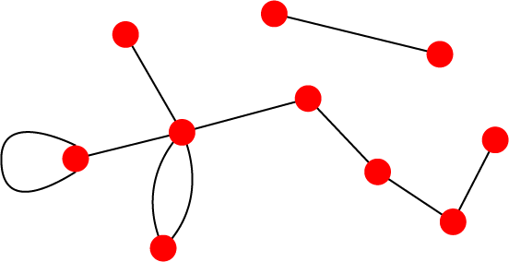




Directed vs Undirected
Undirected
Directed
Links: directed (arcs)
B
C
Links: undirected (symmetrical)
L
A
D
F
M
I
D
B
G
G
E
H
A
C
Examples:
Collaborations
Examples:
Phone calls
Following on Twitter
F
Friendship on Facebook

Slide 35















Node Degrees
Vertex degree, k_{i} (or deg(i)): the number of edges adjacent to node i
Undirected
A
|V|
1
2|E| |V|
Avg. degree:
k= _{|V|} ∑k_{i} =
k_{A} = 4
i=1
In directed networks we define an in-degree and out-degree.
The (total) degree of a vertex is the sum of in- and out-degrees.
B
D
Directed
C
G
E
_{k} out
A
k ^{in} = 2
= 1 k = 3
C
C
C
F
k = ^{|E|}
_{k} in _{= k} out
|V|

Slide 36















Characterization
• Degree: how many friends do I have?
• Path: how far am I from another vertex?
• Connectivity: can I reach other vertices?
• Density: how dense are they?
(Number of edges / Number of possible edges)
Notes:
graph density = no of edges/total no of possible edges.
In directed graph total no of possible edges is |v|*|v-1|, In undirected graph total no of possible edges is |v|*|v-1|/2.

Slide 37










Bipartite Graph
Bipartite graph is a graph whose vertices can be divided into two disjoint sets U and V such that every link connects a vertex in U to one in V; that is, U and V are independent sets
Examples:
Authors-to-Papers (they authored)
Actors-to-Movies (they appeared in)
Users-to-Movies (they rated)
Recipes-to-Ingredients (they contain)
“Folded” networks:
Author collaboration networks
Movie co-rating networks
A
B
C
D
E
U
V

Slide 38
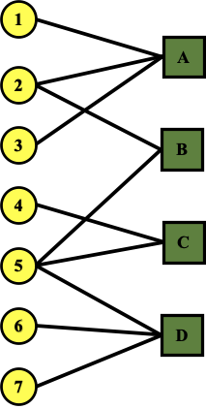
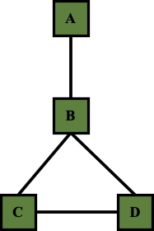
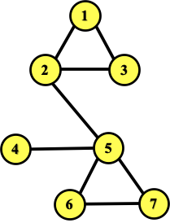
Folded/Projected Bipartite Graphs
Projection U
U
V
Projection V

Slide 39
How to store a graph
Which data structure should we used to represent a graph in Python?
Coding practice~

Slide 40








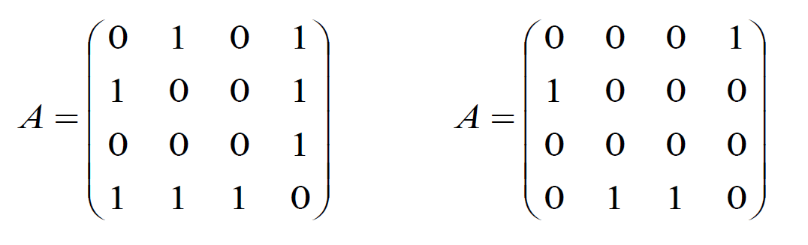
Representing Graphs: Adjacency Matrix
4
4
3
3
2
2
1
1
A_{ij} = 1
A_{ij} = 0
if there is a link from vertex i to vertex j
otherwise
Note that for a directed graph (right) the matrix is not symmetric.

Slide 41
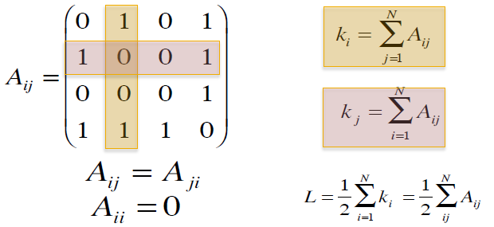




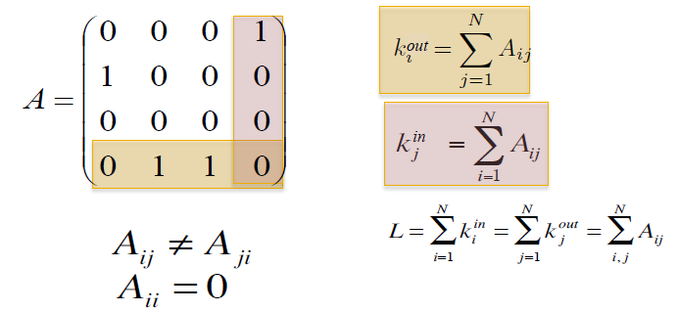




Adjacency Matrix (cont)
4
Undirected
3
2
1
Directed
4
3
2
1

Slide 42
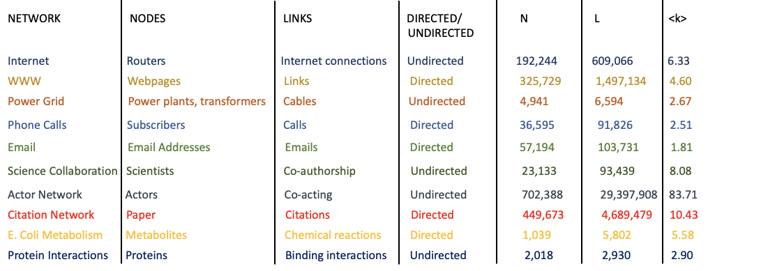
Most real-world networks are sparse
E << E_{max} (or average_degree << |V|-1)
_
V
E
k
Consequence: Adjacency matrix is filled with zeros!

Slide 43

Real Adjacency Matrices are sparse
Scanning neighbors is inefficient
Implement adjacency matrix in Python~

Slide 44





Representing Graphs: Adjacency list
Adjacency list:
Easier to work with if network is
Large
Sparse
Allows us to quickly retrieve all neighbors of a given vertex
1:
2: 3, 4
3: 2, 4
4: 5
5: 1, 2
2
1
3
5
4

Slide 45
Adjacency list (cont)
Implement adjacency list in Python~
Adjacency list:
Easier to work with if network is
Large
Sparse
Allows us to quickly retrieve all neighbors of a given vertex
1:
2: 3, 4
3: 2, 4
4: 5
5: 1, 2
2
1
3
5
4
Space-efficient for sparse graphs
Good for graph updates
Efficient enough?

Slide 46
Quick quiz
Compute the adjacency matrix and the adjacency list of the right graph
4
3
2
2
1
1
3
5
5
4
Degree of each vertex
Density of the graph

Slide 47
Quick quiz
Compute the adjacency matrix and the adjacency list of the right graph
4
3
1: [0, 0, 0, 1, 1]
2: [0, 0, 0, 1, 0]
3: [0, 0, 0, 1, 1]
4: [1, 1, 1, 0, 0]
5: [1, 0, 1, 0, 0]
1: 4, 5
2: 4
3: 4, 5
4: 1, 2, 3
5: 1, 3
2
2
1
1
3
5
5
4
Degree of each vertex
Complexity difference between
the adjacency matrix, the adjacency list and CSR:
1: 2
2: 1
3: 2
4: 3
5: 2
Storage space: ?
Query whether an edge (u, v) exists : ?
5/10 = 0.5
Density of the graph
Get all the neighbors of a vertex v: ?
Notes:
Difference between the adjacency matrix & the adjacency list: storage: O(|V|^2) vs O(E) – whether there exists an edge between every pair of vertices, the edge of adjacent vertices; query whether an edge exists O(1) vs O(n) or O(log(n))-if binary search; query all the neighbors of a vertex v: O(|V|) vs O(deg(v))

Slide 48
Quick quiz
Compute the adjacency matrix and the adjacency list of the right graph
4
3
1: [0, 0, 0, 1, 1]
2: [0, 0, 0, 1, 0]
3: [0, 0, 0, 1, 1]
4: [1, 1, 1, 0, 0]
5: [1, 0, 1, 0, 0]
1: 4, 5
2: 4
3: 4, 5
4: 1, 2, 3
5: 1, 3
2
2
1
1
3
5
5
4
Storage space: O(|V|^2) v.s. O(|V| + |E|)
Query whether an edge (u, v) exists : O(1) v.s. O(|V|)
O(deg(u))
O(min(deg(u), deg(v)))
Get all the neighbors of a vertex v: O(|V|) v.s. O(deg(v))
Notes:
Difference between the adjacency matrix & the adjacency list: storage: O(|V|^2) vs O(E); query whether an edge exists O(1) vs O(n) or O(log(n))-if binary search; query all the neighbors of a vertex v: O(|V|) vs O(deg(v))
Can this be better? binary sort and O(log(deg(v))

Slide 49
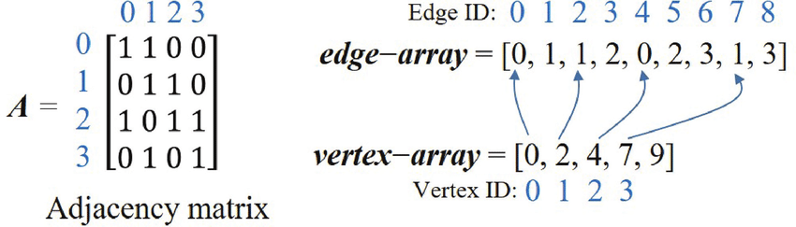
Representing Graphs: CSR
Compressed Sparse Row

Slide 50
Representing Graphs: CSR
Compressed Sparse Row
Implement adjacency matrix in Python~
Space-efficient for sparse graphs
Efficient for static graphs
Hard to update

Slide 51
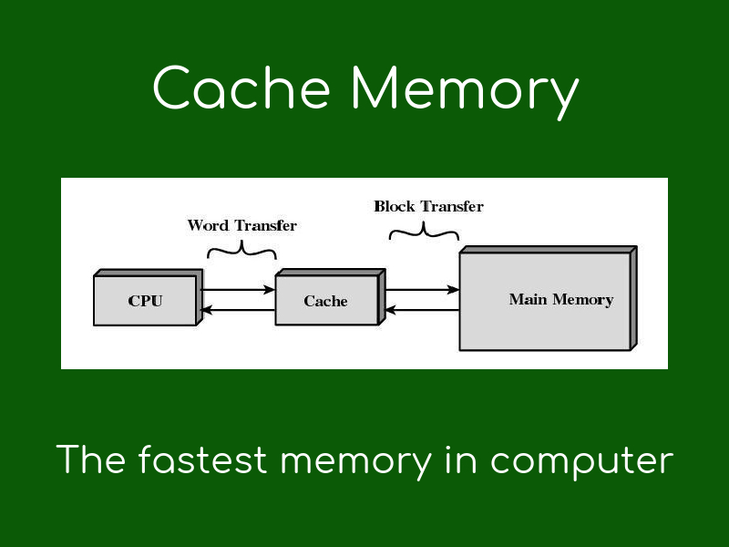
CSR VS Adjacency List
Which one is better?
https://docs.google.com/forms/d/e/1FAIpQLSczUC4X0LQsV0-fKSDbLJ7ve0dfYBBkSCYeLVG0YXs_n-ROXg/viewform?usp=sf_link
How does CPU read data?

Slide 52
CSR VS Adjacency List (cont)
Handing graph updates using adjacency list or CSR
https://docs.google.com/forms/d/e/1FAIpQLSe2oUvaY3n0epFHLAy1sK6P-5nu6W2SSVI2GUuSuk7iE_gT7Q/viewform?usp=sf_link
Notes:
Difference between the adjacency matrix & the adjacency list: storage: O(|V|^2) vs O(E); query whether an edge exists O(1) vs O(n) or O(log(n))-if binary search; query all the neighbors of a vertex v: O(|V|) vs O(deg(v))
Can this be better? binary sort and O(log(deg(v))

Slide 53
A quick summary for graph storage
Adjacency matrix: best for updating, worst for neighbor scanning, worst for big graphs
Adjacency list: good for neighbor scanning, ok for updating
CSR: best for neighbor scanning, worst for updating
Hash Map: hard to choose bucket number
large bucket number: bad for neighbor scanning, good for updating, bad for big graphs
small bucket number: good for neighbor scanning, bad for updating, good for big graphs
Notes:
Difference between the adjacency matrix & the adjacency list: storage: O(|V|^2) vs O(E); query whether an edge exists O(1) vs O(n) or O(log(n))-if binary search; query all the neighbors of a vertex v: O(|V|) vs O(deg(v))
Can this be better? binary sort and O(log(deg(v))

Slide 54
Node and edge attributes
Possible options:
Weight (e.g., frequency of communication)
Ranking (best friend, second best friend…)
Type (friend, relative, co-worker)
Properties depending on the structure of the rest of the graph: Number of common friends

Slide 55
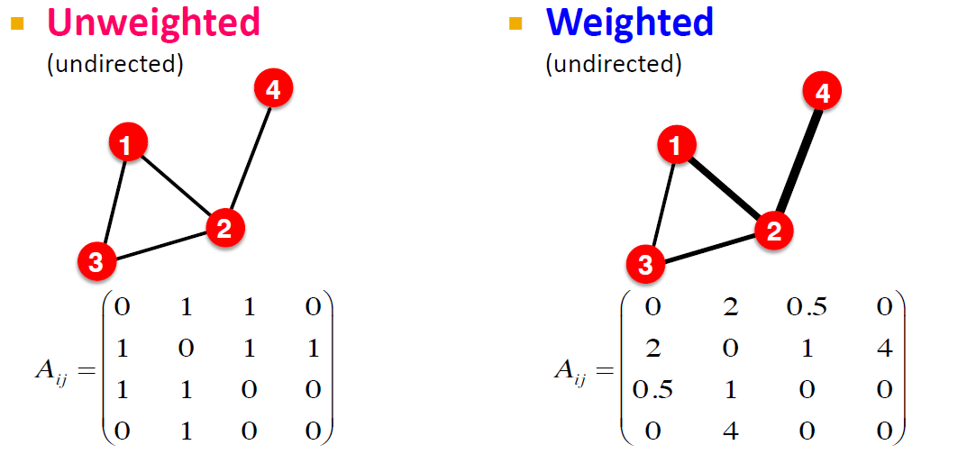
More Types of Graphs
4
2
0.5
1
Examples: Friendship, Hyperlink
Examples: Collaboration, Internet, Roads

Slide 56



Connectivity of Undirected Graphs
Connected (undirected) graph:
Any two vertices can be joined by a path
A disconnected graph is made up by two or more connected components
B
B
A
Largest Component:
Giant Component
A
Isolated node (node H)
F
C
C
D
D
F
H
H
G
G

Slide 57
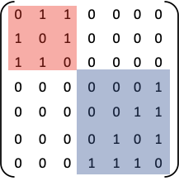
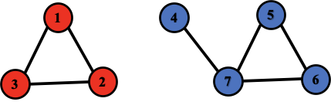
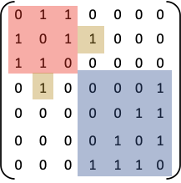
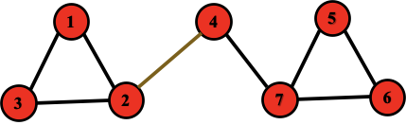
Connectivity: Example
The adjacency matrix of a network with several components can be written in a block-diagonal form, so that nonzero elements are confined to squares, with all other elements being zero:
Disconnected
Connected

Slide 58



Connectivity of Directed Graphs
Strongly connected directed graph
has a path from each vertex to every other vertex and vice versa (e.g., A-B path and B-A path)
Weakly connected directed graph
is connected if we disregard the edge directions
E
B
F
Graph on the left is connected but not strongly connected (e.g.,
there is no way to get from F to G by
following the edge directions).
A
D
C
G

Slide 59
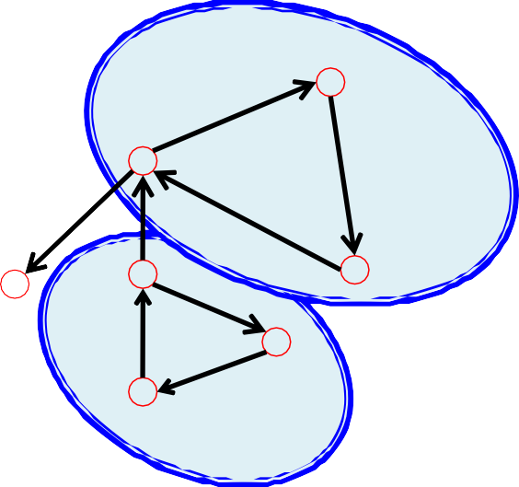
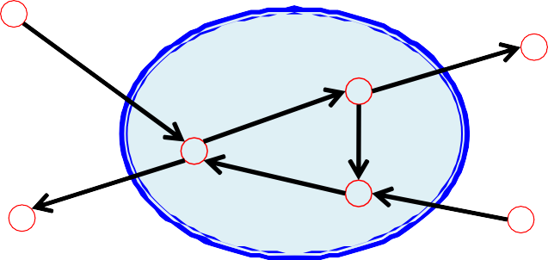
Connectivity of Directed Graphs
Strongly connected components (SCCs) can be identified, but not every vertex is part of a nontrivial strongly connected component.
SCC
B
E
A
B
F
A
D
E
C
F
D
C
G
G
SCC
SCC

Slide 60
Analyzing Graphs

Slide 61


Searching
Find the (shortest) path between two people on Facebook.
Six degree of separation
: only six hops separate any two people in the world
Can you find a path (visible by public) between you and Mark Zuckerberg with at least 3 hops in Facebook ?
You
Notes:
Yelp, Fouresquare,
Reach Mark via facebook friend relationship ?
Survey : some of you mentioned that we can do this via friends working at Facebook, some as my case ☺
How

Slide 62
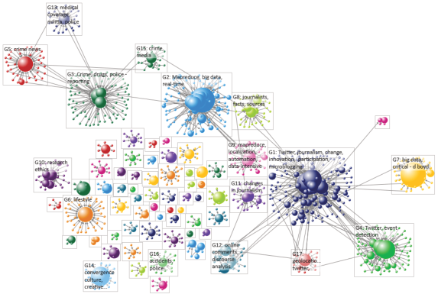
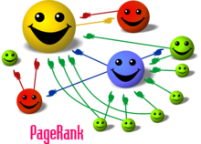
Ranking
Importance of the vertices.
E.g., which is the most influential paper in a co-citation network
https://en.wikipedia.org/wiki/PageRank
https://www.researchgate.net/
Back Mirror : Nosedive (2016)
Notes:
PageRank (PR) is an algorithm used by Google Search to rank web pages in their search engine results. PageRank is a way of measuring the importance of website pages. According to Google:
PageRank works by counting the number and quality of links to a page to determine a rough estimate of how important the website is. The underlying assumption is that more important websites are likely to receive more links from other websites.^{[1]}
What happens if we also have similar ranking systems:
Rank each other, people with high ratings has high weight of their rating
your privilege will be associated with the rating. For example, you will not be able to take a flight if you have a low rate
-- Back Mirror : Nosedive (2016) – some interesting things happens under this rating system.

Slide 63
Finding Communities
Who tend to work together
Information Retrieval
Co-author network
Machine learning
Data Mining
- Q.Mei, D.Cai, D.Zhang, and C.Zhai, Topic Modeling with Hitting Time, WWW 2008
Notes:
More applications.
----------------------

Slide 64
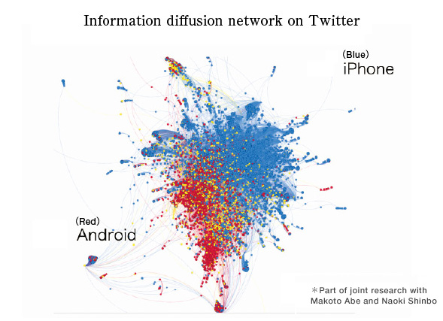
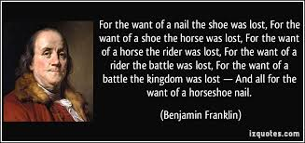
Network Dynamic Analysis
Cascade behaviour from node to node like an epidemic
E.g.,
– Marketing, online advertising
– News, opinions, rumours, virus
– Adoption of innovation
– Joining a community, buying a book
Notes:
Like to copy other’s behaviour , say half of you turn back xx ( word of mouth advertisement )
Some behaviour may cascade unexpectedly (e.g., virus)
Butter fly effect in chaos theory: Does the flap of a butterfly’s wings in Brazil set off a tornado in Texas?
loss of a horseshoe nail –> the loss of a kingdom because of a horseshoe nail.

Slide 65
Applications of Graphs

Slide 66
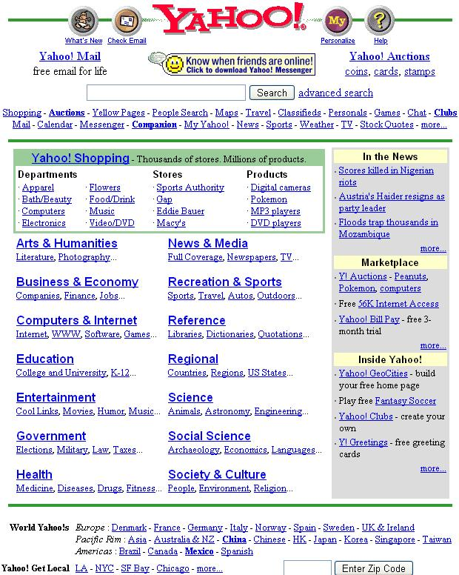
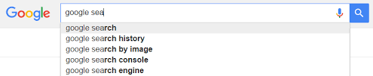

Web search
Yahoo directory
Notes:
Yelp, Fouresquare,

Slide 67
Web search
Find the relevant webpages (relevance)
Rank the search results (by importance)
Notes:
Yelp, Fouresquare,
"Please translate these roman numerals mcmxcviii thank you.“ - Grandama
Google UK thanked “Ben’s Nan” saying: “In a world of billions of searches, yours made us smile. “Oh, and it’s 1998,” it added. “Thank YOU”.

Slide 68
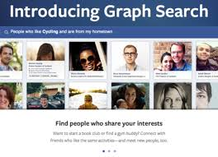
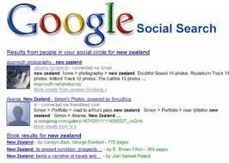
Social search
Social Search is an enhanced version of web search, also takes into account social relationships between the results and the searcher, such as work for the same companies, belong to the same social groups etc.
Facebook graph search
Notes:
work for the same companies, belong to the same social groups etc.

Slide 69




Recommendation
http://www.kis.kansai-u.ac.jp/res_music_e.html

Slide 70








RESEARCH
ON GRAPH:
GRAPH PROBLEM
Link Analysis (relevance)
Pagerank
GRAPH MODEL
APPLICATION
SimRank
Link Prediction
Clustering
Traditional Graph
Recommendation
REAL DATA
Degree/Neighbors (structural)
Streaming Graph
Cluster Coefficient
Triangle
Vertex Cover
Anomaly Detection
Money Transactions
Visualization
Heterogeneous Graph
Distance/Path (reachability)
Reachability
Protein Interactions
Cybersecurity
Knowledge Graph
Shortest Path
Spanning Tree
Steiner Tree
Internet
System
K-Hop
Centrality
KNN
Keyword Search
Fraud Detection
Medical Records
Attributed Graph
Subgraph Detection
Marketing
Graph Similarity
Phone Calls
Temporal Graph
Cohesive Subgraph
Subgraph Enumeration
Legal Reasoning
Road Map
Promotion
Evolving Graph
Propagation
Influence Maximization
Social Network
Traffic Monitoring
. . .
Uncertain Graph
Information Cascade
Label Propagation
. . .
Node mapping (Embedding)
Virus Control
. . .
Node2Vec
AI4DB
Graph Analytics System
Graph Database

Slide 71
Learning outcomes
Understand the basic graph structure and how to represent a graph
Know about characterization of graphs
Know about different types of graphs
Your feedback is really important to improve this course.
Send me an email if you have any comment or suggestion.

